Slide 1
New Vocabulary 2nd Grade
Synonyms Antonyms and Homophones
By: Sabrina Carey
March 6, 2012

Slide 2
Purpose of the lesson
Students will learn how to identify, define, and locate the following:
Antonyms
Synonyms
Homophones

Slide 3
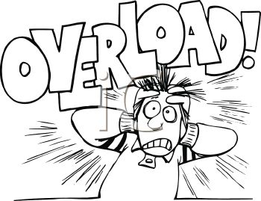
Mine
Mine
Fast
Slow
Hot
Cold
See
Sea
Right
write
I
Eye
Happy
Sad
By
Bye
Knight
Night
Dirty
Clean
Son
sun
Sew
so

Slide 4
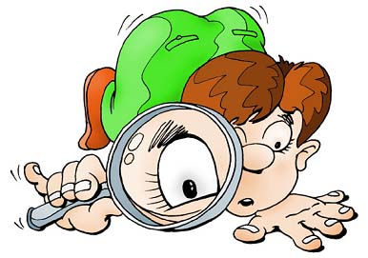
Lets take a closer L k!!
Click on the ants

Slide 5
KWHL
Know -
Want to know -
How we know -
What we’ve learned -

Slide 6
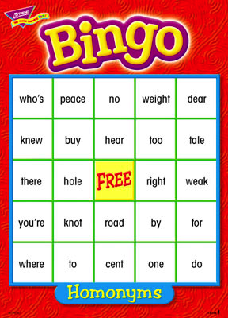
Let’s Play
Students will play a game as a class to learn more about synonyms, antonyms and homophones.

Slide 7
What is this all about?
Lets ask someone who might know.
Click on the question mark.

Slide 8
Add to the L column in the KwHl chart. what have we learned so far?

