Slide 1
Homophones
Click on the teacher to complete a homophone quiz as a class

Slide 2
Test your skills
Hot
Cold
Click on the frog

Slide 3
Jump!!
Click on a jumper to learn how to play the synonym-antonym jumping game

Slide 4
Quick Quiz
1. Which of the following are synonyms?
a. Day & Night b. Evening & Night c. Knight & Night
2. Which of the following are antonyms?
a. Wet & soggy b. Wet & Dry c. Wet & Water
3. Which of the following are homophones?
a. Money & Cash b. Run & Walk c. Meat & Meet
4. Give a synonym for Mad ___________
5. Give an antonym for Fast __________
6. Give the two meanings of bat _______ ________

Slide 5
Class Discussion

Slide 6
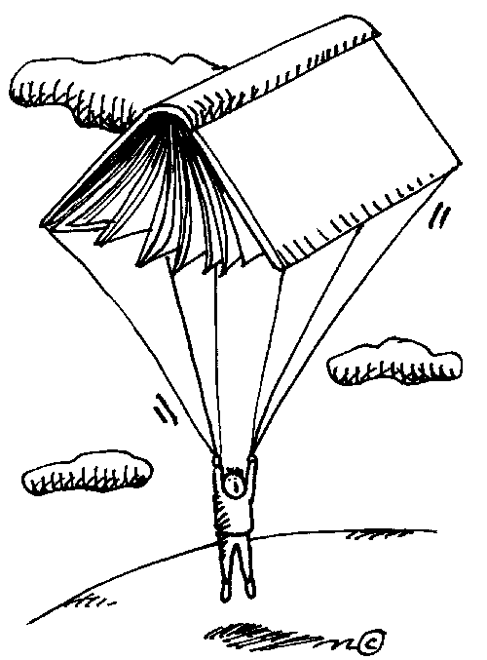
C o m p l e t e KWHL Chart

Slide 7
THE END
References
Homophones, synonyms, and homophones video. (2009).Youtube . Retrieved, March 7, 2012, from
http://www.youtube.com/watch?v=YMMvysf6fug
Homophone quiz. (2012).apples 4 the teacher. Webstantaeous Web Marketing. Retrieved, March 7, 2012, from
http://www.apples4theteacher.com/quiz/homophones.html
My Voki. (2012).Voki. Retrieved, March 7, 2012, from http://voki.com/
Word Frog. (2012).Arcademics. Retrieved, March 7, 2012, from
http://www.arcademicskillbuilders.com/games/frog/frog.html

